Slide 1
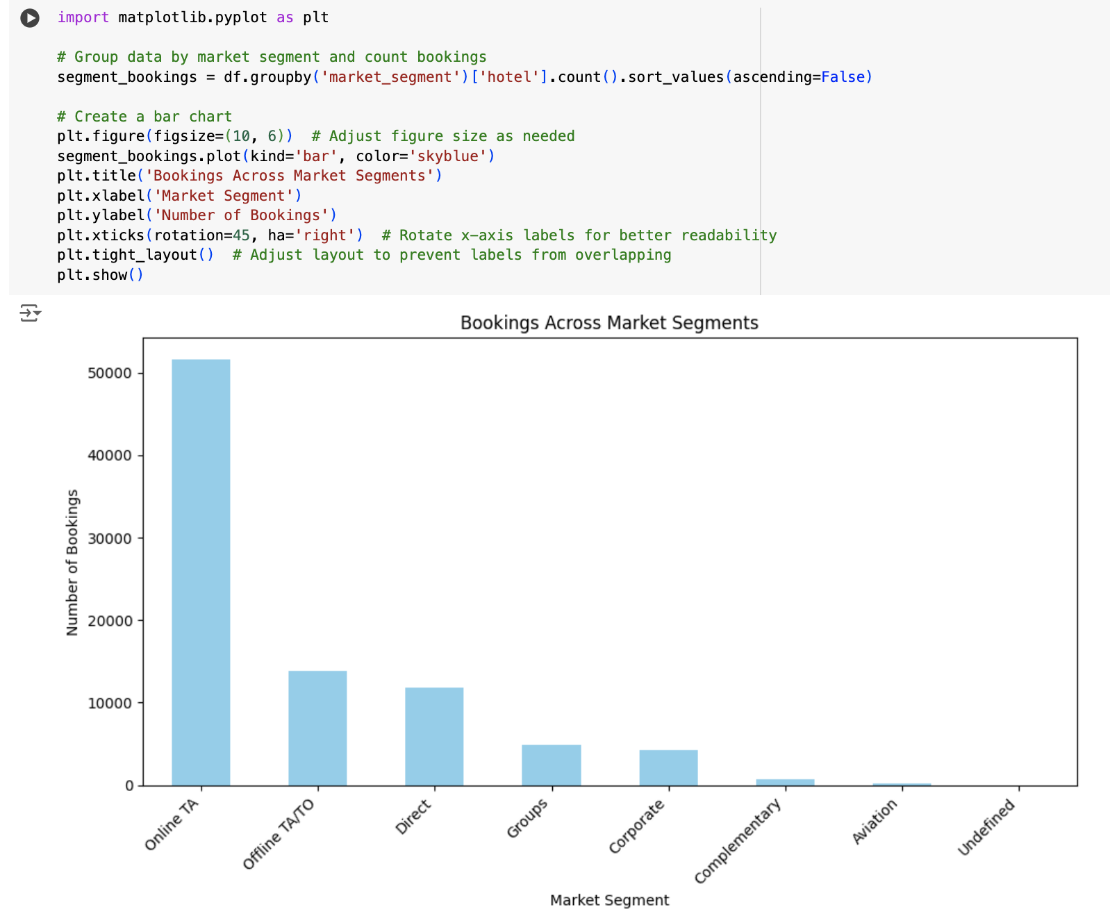
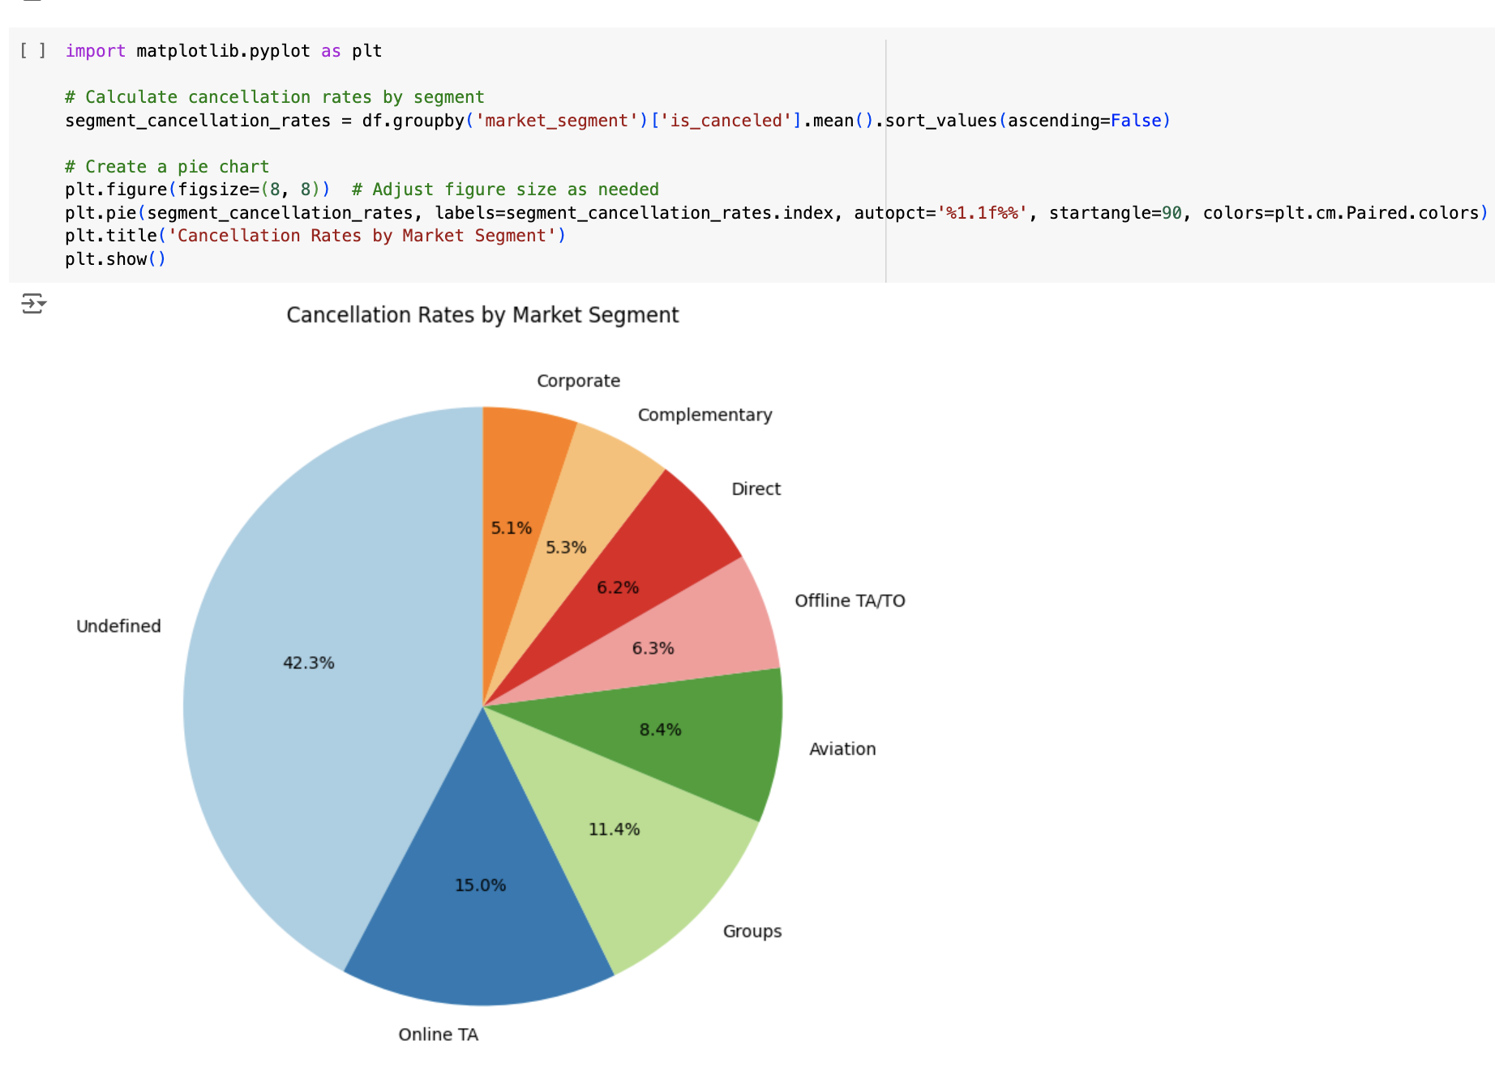
Hotel Bookings Python Project
Nathan Weir

Slide 2
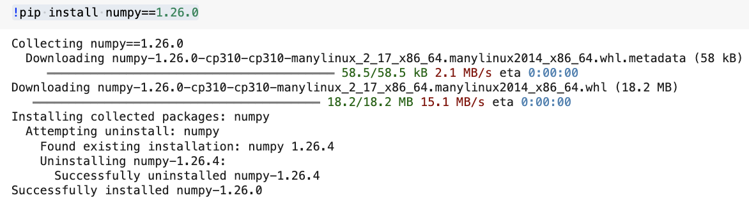
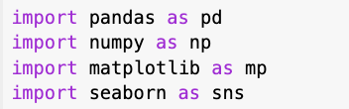
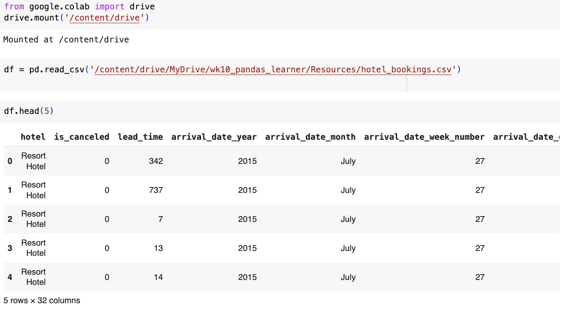
Setting up Google Colabs
I completed this Python project using Google Colabs.
The first step was to install and import pandas, numpy, matplotlib and seaborn s these libraries will be crucial for later data cleaning, analysis and visualization.
I then mounted my Google Drive to allow me to access the dataset.
The dataset for this project was an Excel dataset, so I converted it to a CSV and then uploaded it to my Google Drive so that I could access it from Google Colabs.

Slide 3

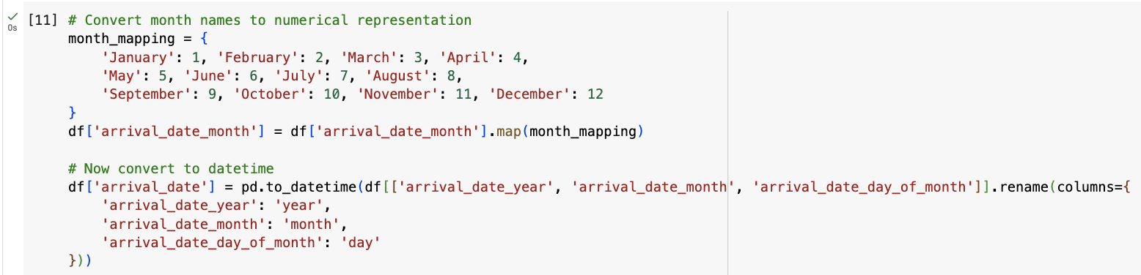
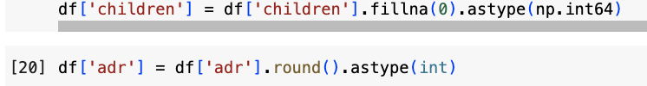
Data Cleaning
Drops duplicate columns.
Drops rows with missing values
This combines all 3 of the arrival date columns into one arrival date column with the datetime format.
I also removed columns ‘meal’, ‘required_car_parking_spaces’,
I used the code df.dtypes to check all the data types for each column. I then changed data types using the code:

Slide 4
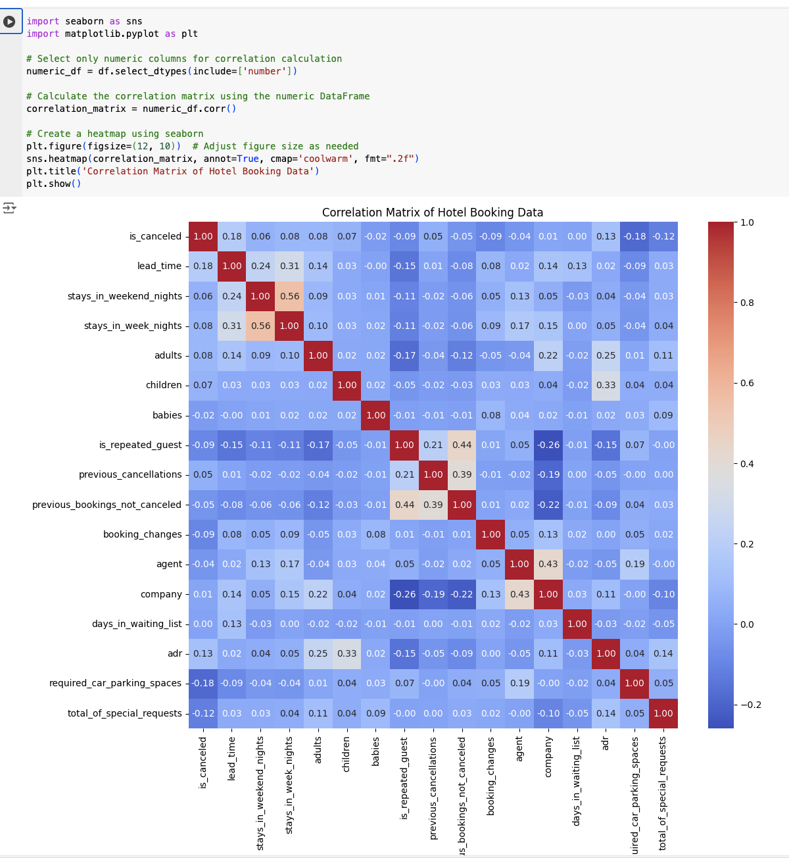
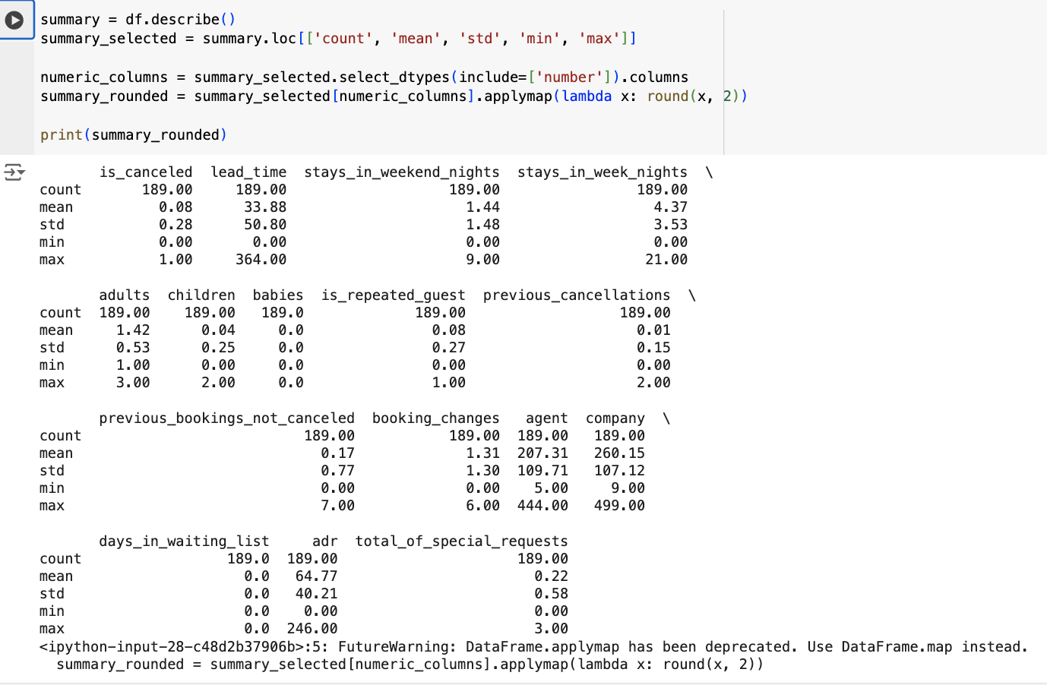
Descriptive Statistics and Correlation Matrix

Slide 5
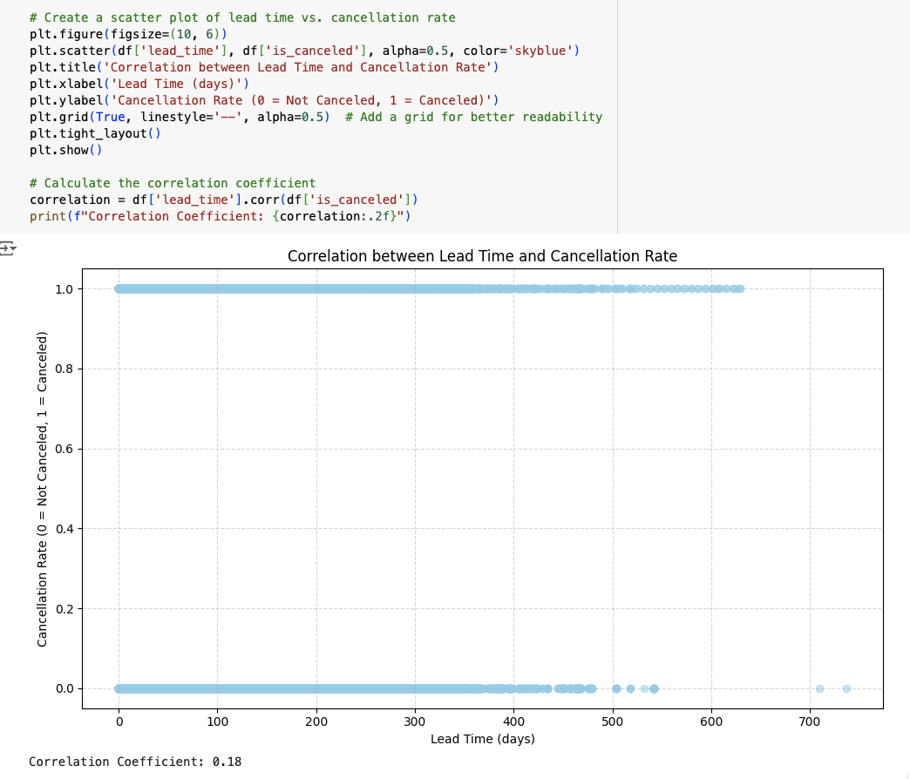
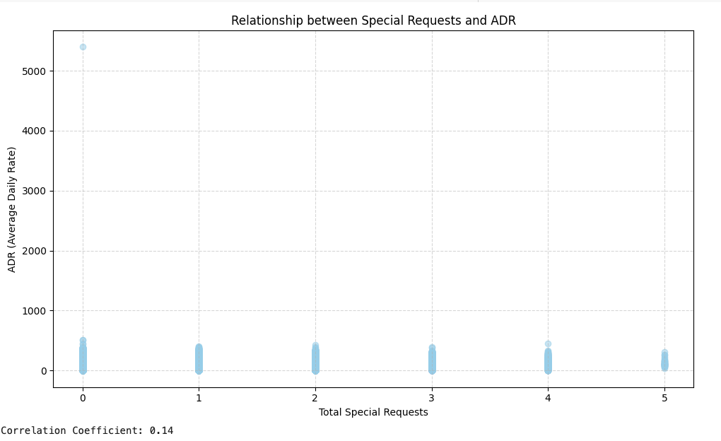
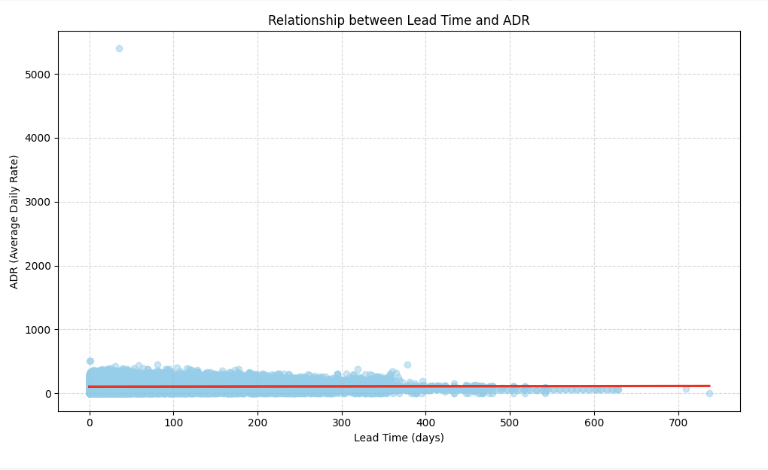
Correlations Visualised
As seen in the correlation matrix, there are no meaningful correlations between variables.

Slide 6
Exploratory Data Analysis
This shows that Online Travel Agencies (TA) have the most bookings by a large margin. Whereas aviation is where the least amount of bookings occur.
The hotel should focus its marketing on online travel agencies through ads and partnerships with these travel agencies to promote this hotel above others.
Furthermore, they can enhance the hotel's website with user-friendly booking features, attractive visuals, and compelling content to encourage direct bookings. They can then implement loyalty programs to reward direct bookings and incentivize repeat business. Offer exclusive benefits, such as discounts, room upgrades, or early check-in/late check-out.

Slide 7
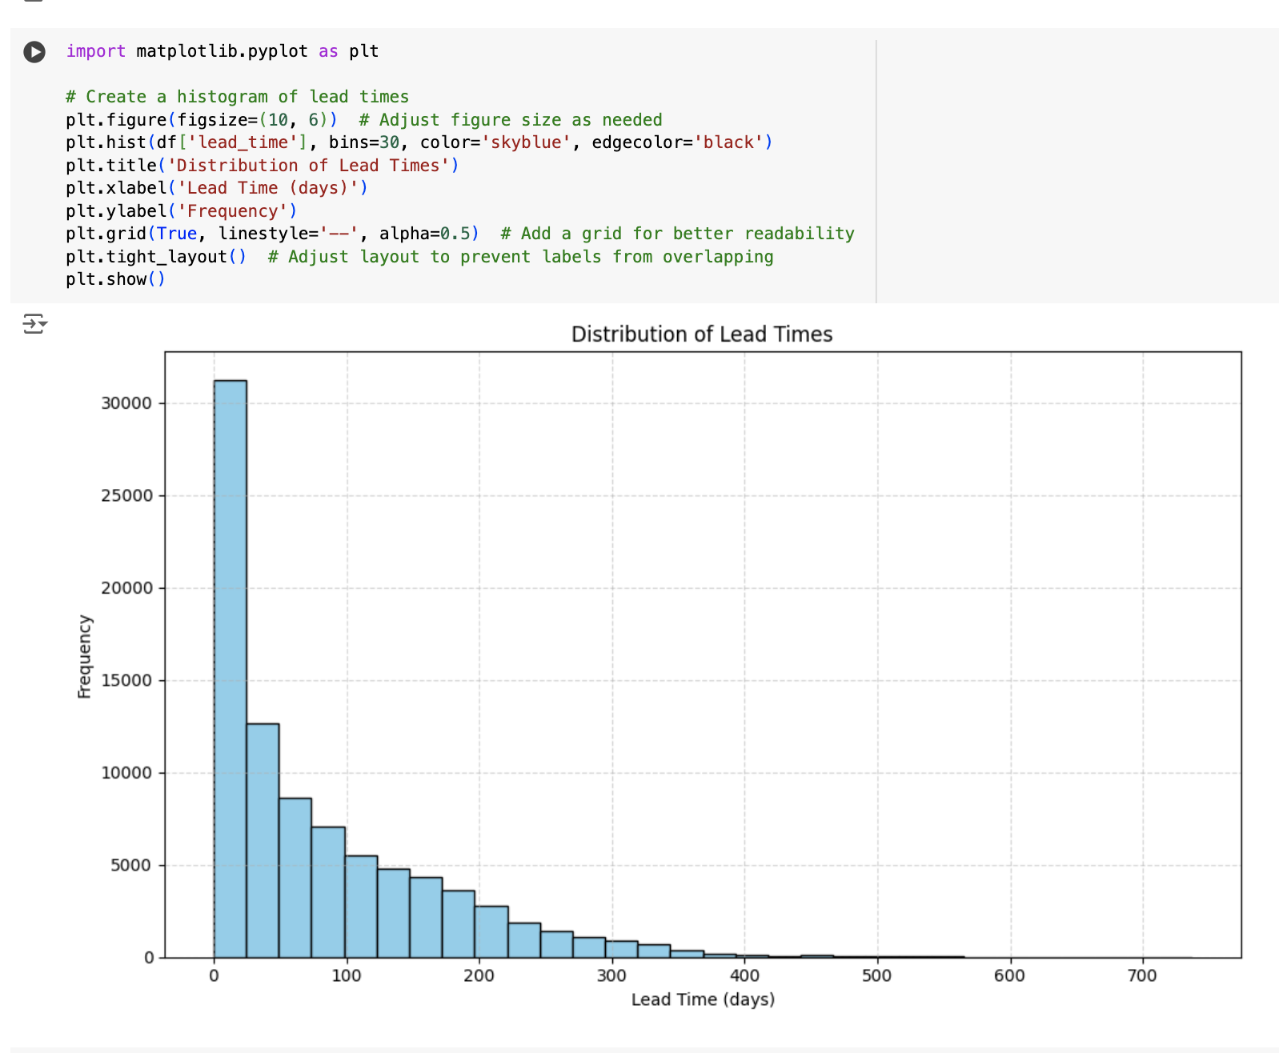
From the histogram of lead times, we can observe that the distribution is positively skewed. This means that the tail of the distribution is longer on the right side, and most of the data is concentrated on the left side. This means the majority of lead times are short, between 0-25 days, with the mean lead time being 33.88 days.
Travellers with shorter lead times may be less price-sensitive and have fewer options compared to travellers with longer lead times. Those with shorter lead times may be more likely to be solo travellers with flexible schedules rather than families who need to plan trips further in advance.
Notes:
Lead time provides valuable insights into traveller behaviour and booking patterns. Understanding how it affects price sensitivity, flexibility, trip purpose, and cancellation behaviour allows hotels and businesses to optimize pricing strategies, inventory management, and marketing efforts to target different customer segments effectively.

Slide 8
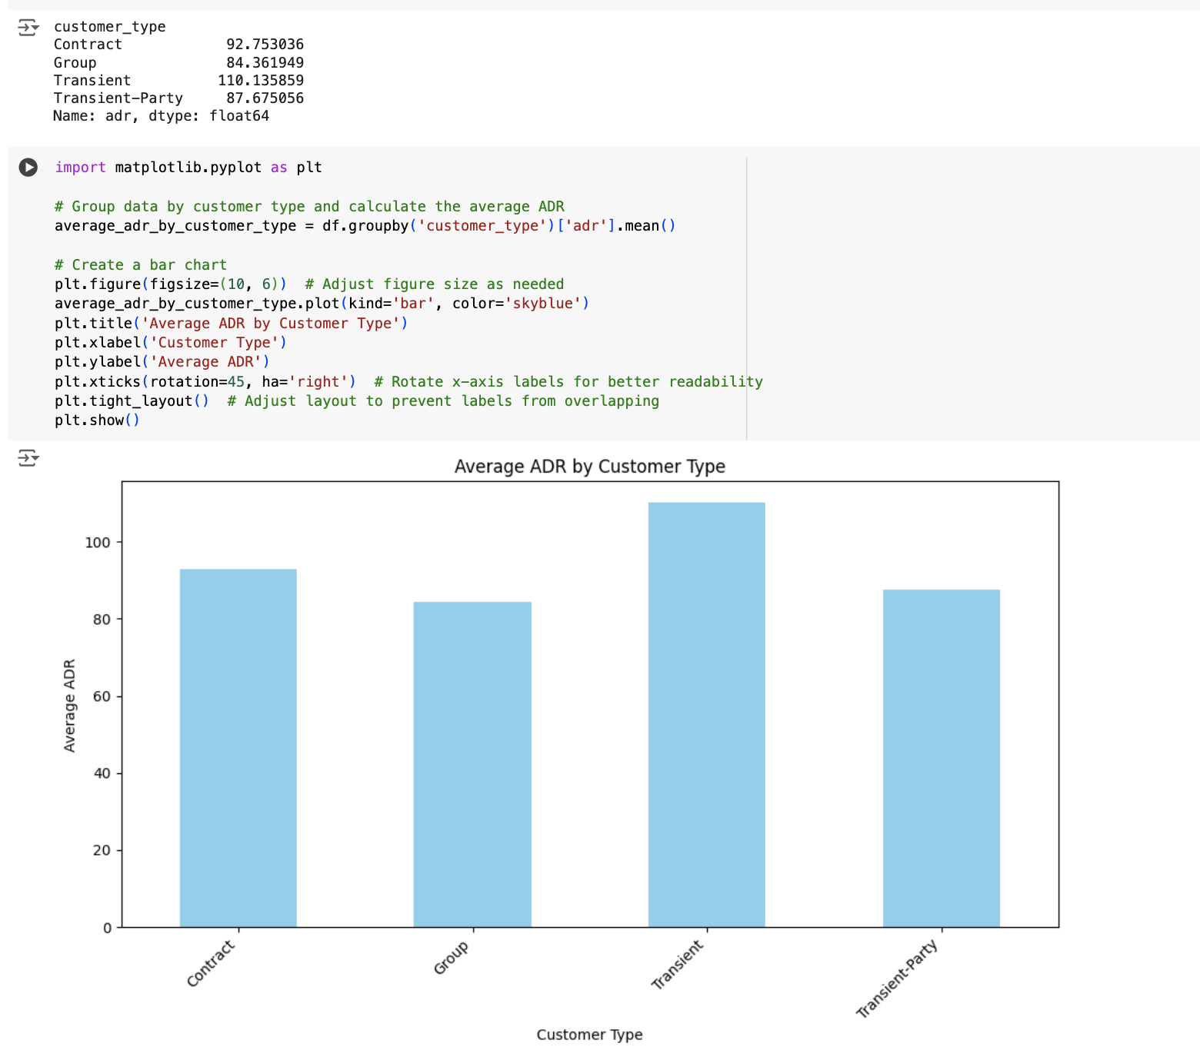
The transient customer type has the highest average ADR (average daily rate) and so are the most valuable customers for the hotel in terms of revenue, with Group customers having the lowest ADR and being a less valuable customer type.
The hotel could use dynamic pricing and premium packages to capitalise on Transient customers' higher spending potential. Furthermore, the hotel could offer tailored upgrades and exclusive amenities to increase appeal and justify higher ADRs for Transient customers. This hotel business should also use revenue management systems to adjust prices dynamically based on demand and customer type for better revenue outcomes. For Contract and Group bookings, they should prioritise volume and occupancy over ADR to boost revenue. Marketing more towards transient customers to capture a larger share of these travellers will also further boost revenue.

Slide 9
Undefined is the market segment with the greatest cancellation rates, to sufficiently investigate this we need more data to determine where these bookings are coming from.
The segment with the next greatest cancellation rates is Online TA; this may be because of flexible cancellation policies and price comparisons, making it easier for customers to change their plans without significant penalties. Group bookings may also have higher cancellation rates due to the challenges of coordinating a large group of people.
Some strategies to reduce cancellation rates include:
Discounted non-refundable bookings
Bookings require deposits
Email reminders in the months/weeks/days before bookings
Loyalty bonuses
Small amounts of overbooking to ensure every room is filled.

Slide 10
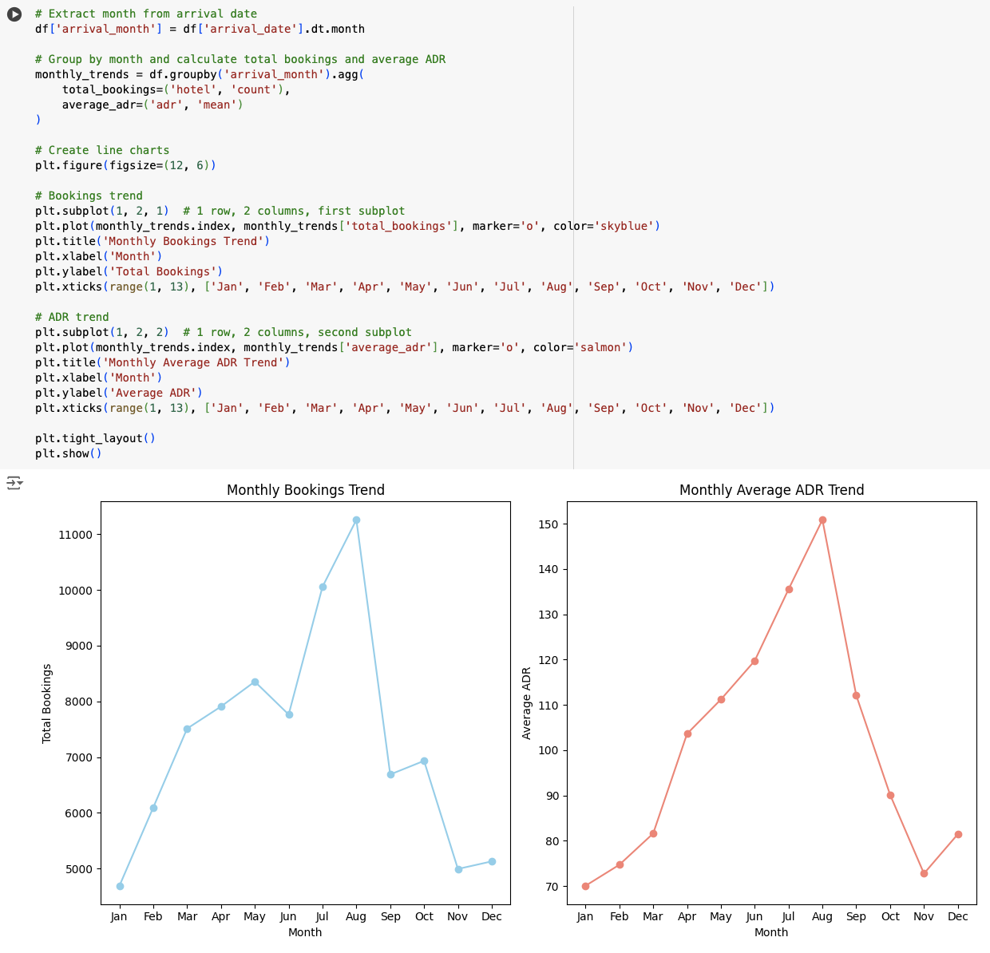
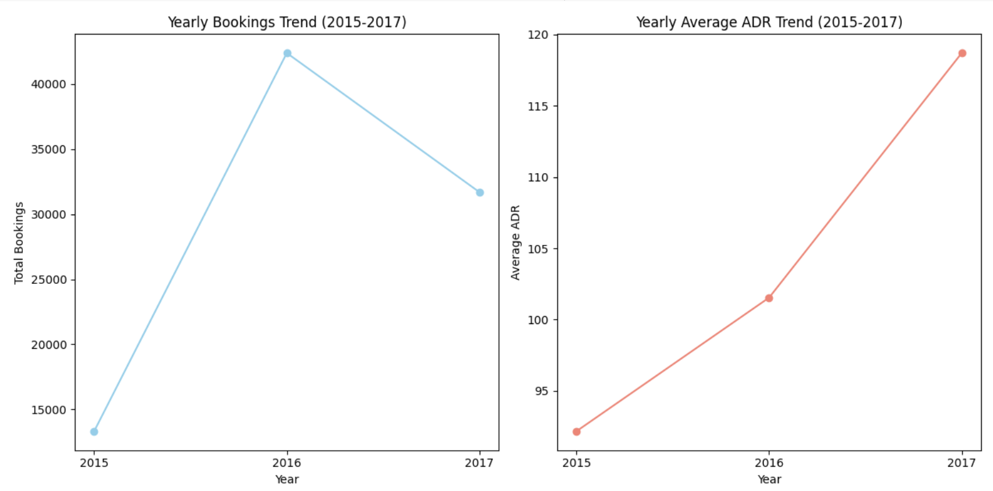
The yearly booking trends show an overall growth from 2015-17, although bookings have reduced from 2017 compared to what they were in 2016. The average ADR for hotel has had a sharp increase from 2015-17.
The monthly booking trends likely reveal a clear peak season during the summer months (June, July, August) and a secondary peak around year-end holidays (December), which is consistent with typical travel patterns. April, May, September and October, typically show moderate booking levels. January, February and November show lower booking activity.

Slide 11
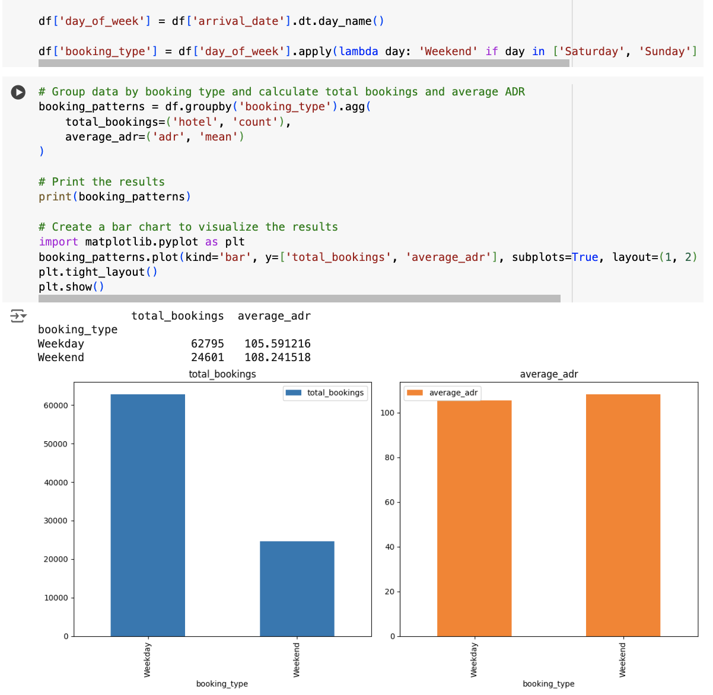
The bar chart for "total_bookings" clearly shows that weekdays have a significantly higher number of bookings compared to weekends.
The bar chart for "average_adr" shows that the average daily rate for weekdays is slightly lower than for weekends, but the two values are almost identical.
The higher number of bookings on weekdays suggests that a significant portion of the hotel's business may come from business travellers who typically travel during the week.

Slide 12
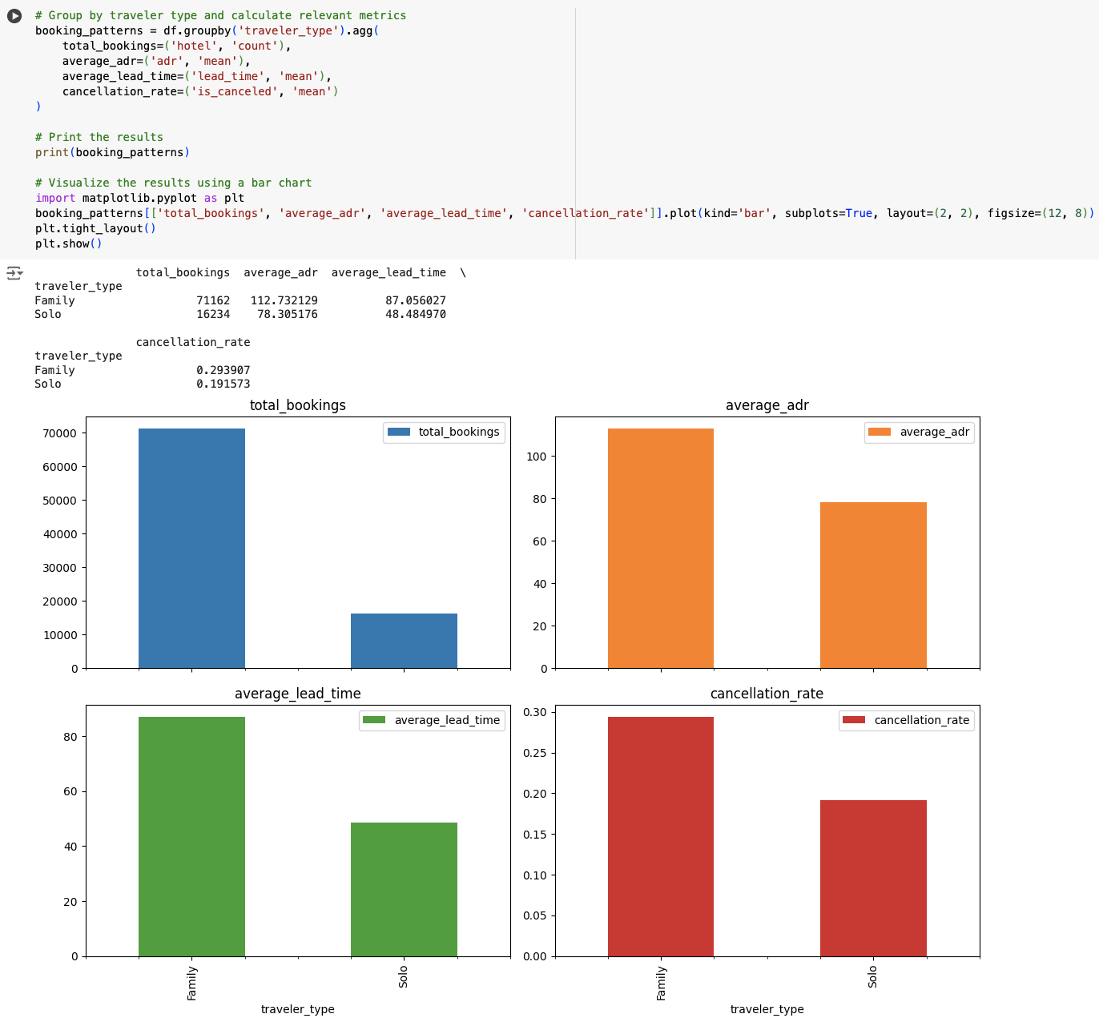
Total bookings:
This shows that solo travellers have a considerably higher number of bookings compared to families.
Average ADR:
Families tend to have a higher average daily rate (ADR) compared to solo travellers.
Average lead time:
Families generally have a longer average lead time, meaning they book their stays further in advance compared to solo travellers.
Cancellation rate:
Solo travellers have a lower cancellation rate, suggesting they may be more likely to stick to their travel plans once they've booked.

Slide 13
Recommendations
Marketing strategies to target high-value customers:
As discussed earlier to target high-value customers, the hotel could offer dynamic pricing, premium packages, loyalty rewards, tailored upgrades and exclusive amenities to justify higher ADRs for Transient customers. These offers should occur in the form of email marketing, social media posts, website advertisements and promotions on online travel agents through partnerships.
This hotel business should also use revenue management systems to adjust prices dynamically based on demand and customer type for better revenue outcomes. For example, for Group and Transient-party bookings they should prioritise volume and occupancy over ADR and so slightly reduce price to boost revenue.
Lead times:
Consider a slight price increase (5-10%) for short lead time bookings to capture potential last-minute demand and maximize revenue, occupancy levels and competitor pricing should also be considered when adjusting price.
Offer discounts or packages (5-10%) to incentivize early bookings and secure revenue in advance. This can help fill rooms during periods of lower demand. You can also tailor these offers to specific customer segments, such as families or business travellers.
Adjust pricing based on seasonal demand patterns. For example, during peak seasons, you might implement higher price increases for short and medium lead times.
Some strategies to reduce cancellation rates include:
Discounted non-refundable bookings
Bookings require deposits
Email reminders in the months/weeks/days before bookings
Loyalty bonuses
Small amounts of overbooking to ensure every room is filled

Slide 14
Conclusions
Online TA is the most valuable segment and Transient customers are the most valuable to this hotel.
There is a general trend of increased bookings from 2015-17, with 2017 being slightly lower than 2016, which may be a slight concern for the hotel. ADR has also sharply increased each year.
Bookings tend to be highest in the summer months and lower in the winter months, the same is true for ADR as it tends to be higher in the summer months and lower in the winter months due to changes in demand.
The hotel should implement the strategies provided to reduce the high cancellation rates for group bookings.
Another potential issue for this hotel is the over-reliance on OnlineTA’s for bookings, the hotel should focus on increasing their bookings in other departments such as direct and corporate bookings.

